Slide 1






Smart Exhaust Fan
Rohit M
(210701215)
Santhosh M
(2107012133)

Slide 2



Introduction & Purpose
The project focuses on creating a smart exhaust fan system using the ESP32 microcontroller. This system is designed to monitor environmental conditions like gas levels, temperature, and humidity through the MQ-2 Gas/Smoke Sensor and the DHT11 Humidity Temperature Sensor. The data from these sensors is sent to the Blynk Dashboard, allowing for real-time monitoring. This project aims to modernize traditional ventilation systems by leveraging IoT technology for better performance, user experience, and the prevention of indoor issues like mold growth and odors, ultimately enhancing overall indoor comfort and living standards.

Slide 3

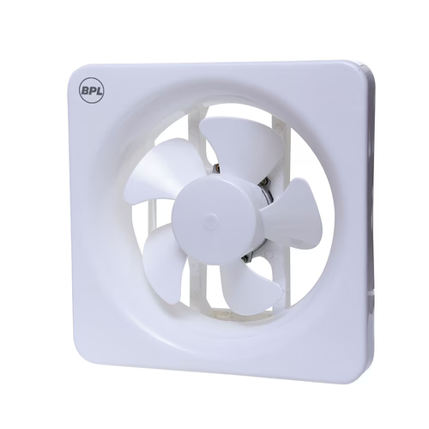
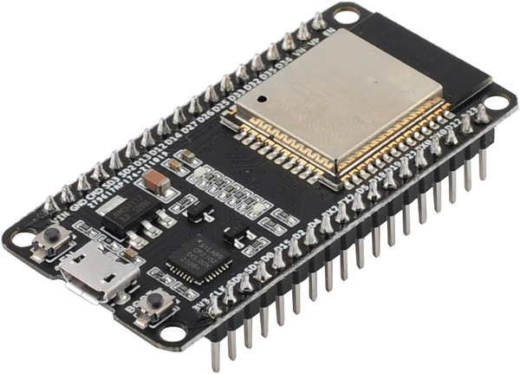

Components
Exhaust Fan
To automatically rotate the fan when sensor readings are high.
2. ESP32 Dev Module
The brain of the system, processing sensor data and controlling the fan. Connects to various sensors and the Wi-Fi module.

Slide 4
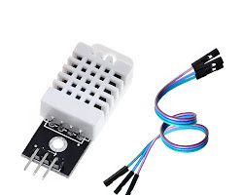
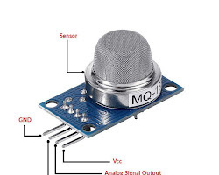
Components
3. DHT11 Sensor
Measures moisture levels in the air and monitors ambient temperature.
4.MQ-02 sensor
The MQ-2 senses combustible gases including LPG/Propane, Butane, Methane, Hydrogen, and Alcohol.The ideal sensing condition for the MQ2 is 20°C ±2°C.

Slide 5
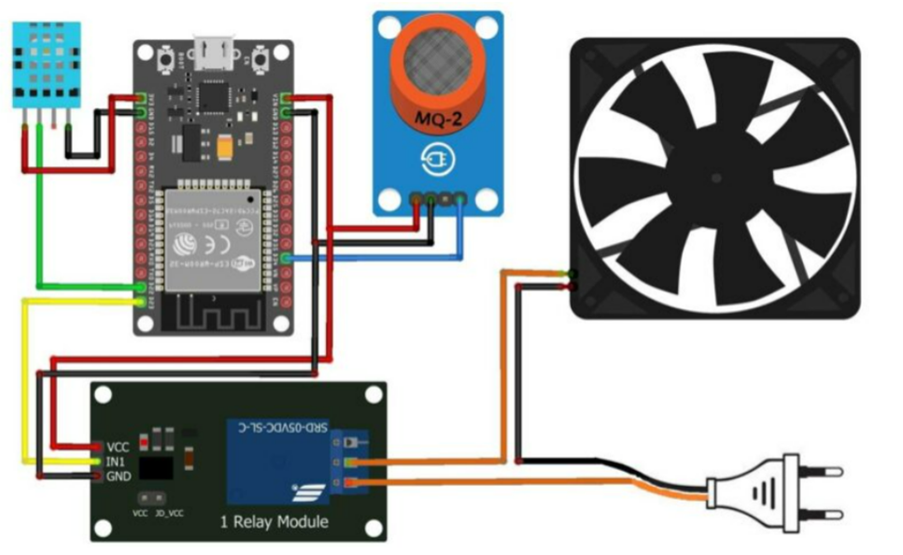

Circuit Diagram

Slide 6

Result
Reduced Energy Consumption: The fan will only operate when necessary based on sensor data, saving energy compared to traditional exhaust fans that run continuously.
Enhanced Convenience: Sensors can automatically activate the fan based on real-time conditions, eliminating the need to manually adjust settings based on guesswork.
Data Monitoring: You can track air quality metrics over time through the app, allowing you to identify trends and make adjustments to optimize ventilation further.

Slide 7
Conclusion
An IoT-based smart exhaust fan offers a compelling solution for improving indoor air quality and ventilation control. This project demonstrates the feasibility of integrating sensors, microcontrollers, and internet connectivity to create a dynamic system that adapts to real-time conditions.
By automatically adjusting fan operation based on air quality, humidity, and temperature, this project contributes to a healthier living environment and potentially reduces energy consumption.
The ability to monitor air quality metrics and control the fan remotely adds to the overall value proposition.

Slide 8
Future Enhancement
Integrating the system with other smart home devices for even more comprehensive air quality management.
Predictive Maintenance: Analyze sensor data to predict potential fan issues and schedule maintenance before breakdowns occur.

Slide 9

Thank You

